Slide 1
E Library LMS
Arpan Pokharel (075bct015) Bibek Basyal (075bct097) Chirag Lamsal (075bct032)

Slide 2
Objectives
To understand data structure and algorithm concept using C++.
To develop creativity and individuality in problem solving, performing tasks and teamwork
To make us able to work in major projects in coming future.

Slide 3
Introduction
This project implements a digital library system.
It aims to make the use of library user friendly and easier.
It aims to reduce the time consumed for finding a book and the work load of the library staff.

Slide 4
Features
Create,Read,Update,Delete(CRUD)operations for students and book records.
Users to search and preview books.
User to sort and preview books.
View their records DIGITAL LIBRARY SYSTEM

Slide 5
Existing system
Any information regarding a book, its availability or cost has to be gained from the librarian.
Users have to browse the library manually to find a book with required content.
In short the existing system has a lot of disadvantages.
Limited knowledge.
Less interaction.
Time consuming.

Slide 6
Proposed System
The application can search for all the books by title, author or subject, preview their contents
The proposed systems aims to overcome drawbacks of existing system and:
Reduce time and effort required to find books.
Make the use of library user friendly and efficient.
Improve efficiency and quality of service.

Slide 7
Implementation
This application allows three modules:
Administrator
Student
Librarian

Slide 8
Administrator
Add Student/Book
Modify Student/Book
Delete Student/Book
Search Student/Book
Sort Student/Book
List Student/Book
Reset Admin/librarian password

Slide 9
Student
Search book
Sorted Book list

Slide 10
Librarian
Issue Book
Deposit Book

Slide 11
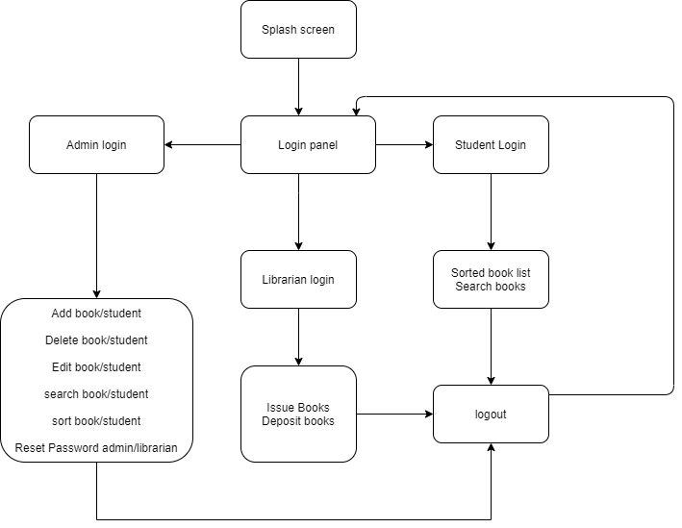
Flowchart

Slide 12
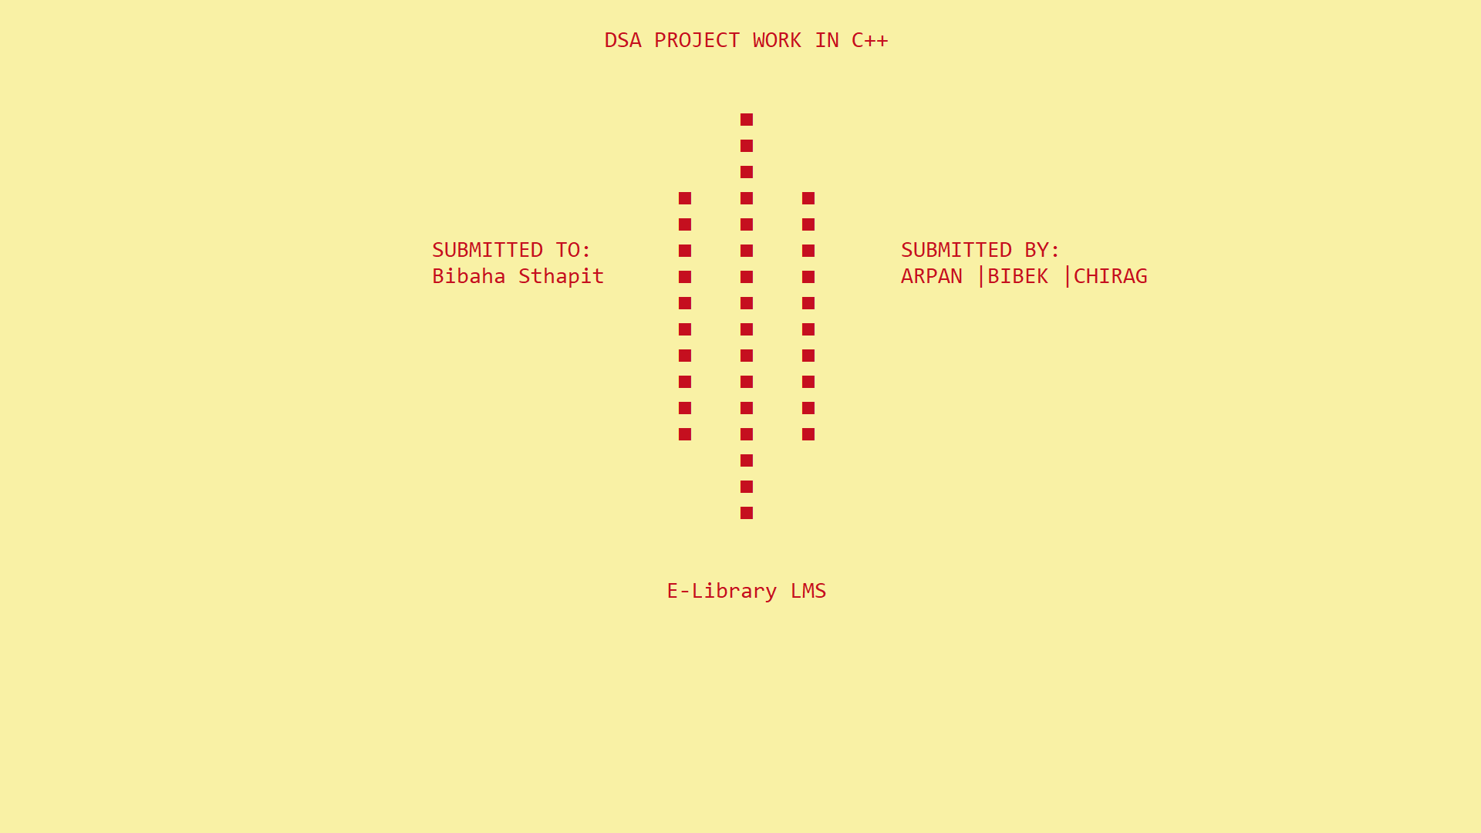
Screenshots

Slide 13
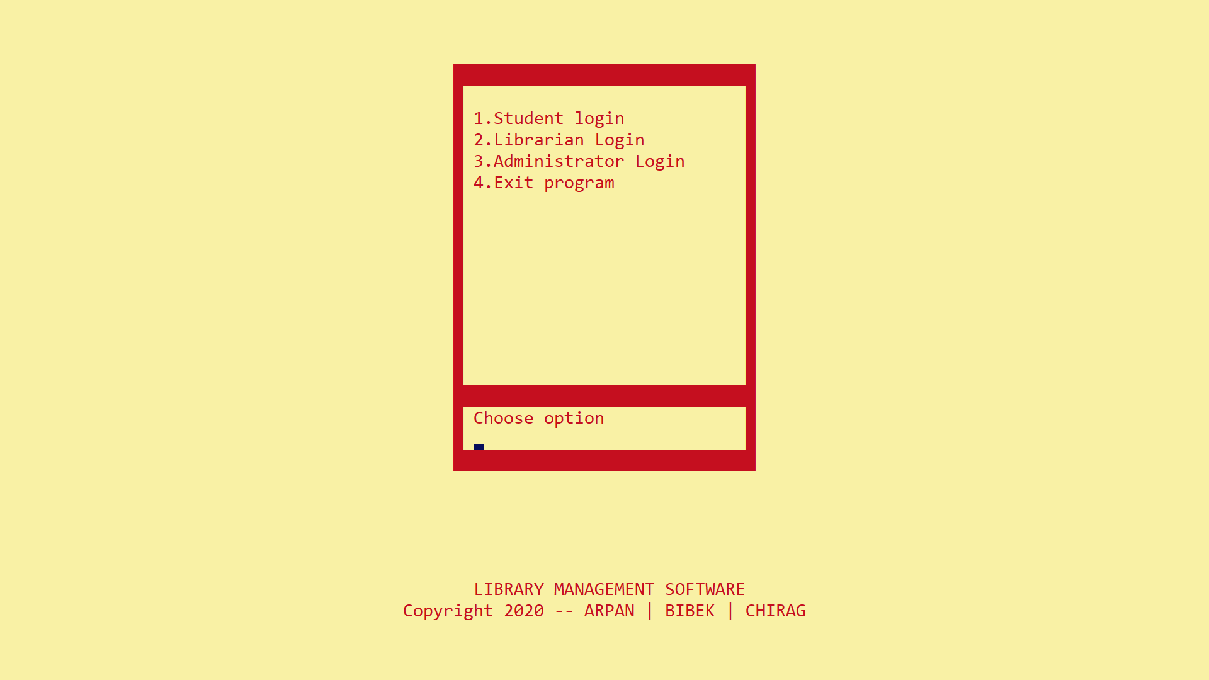
Screenshots

Slide 14
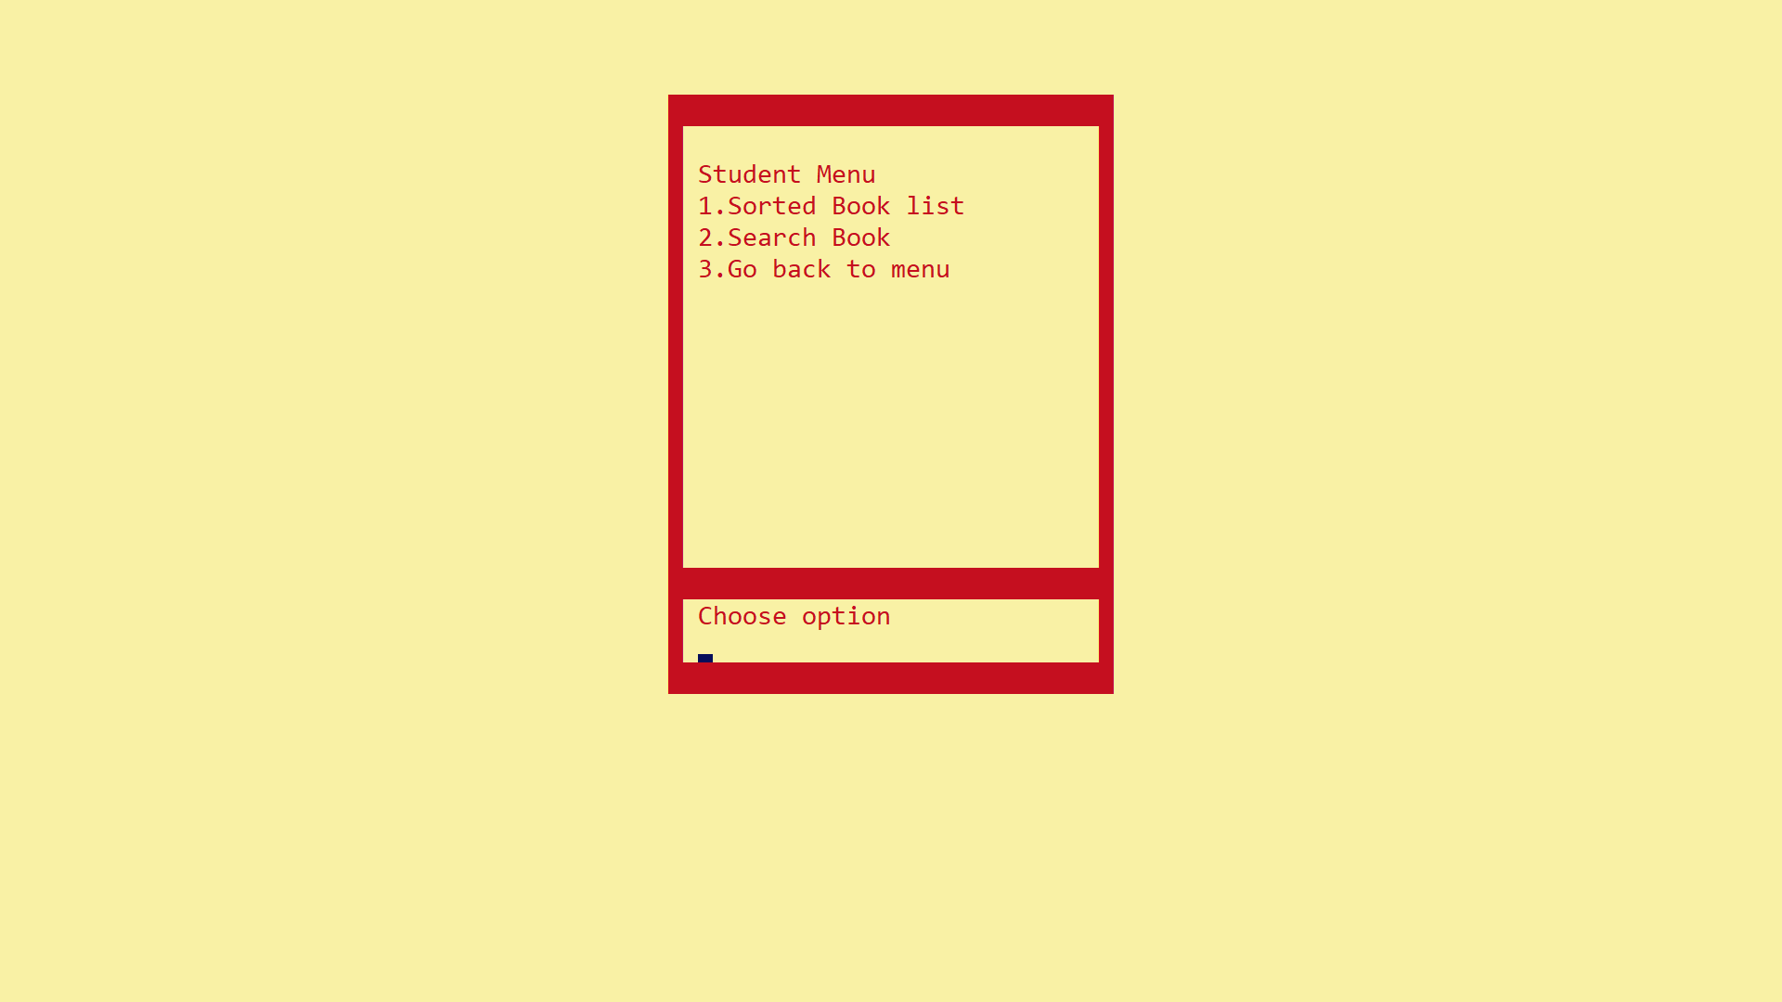
Screenshots

Slide 15
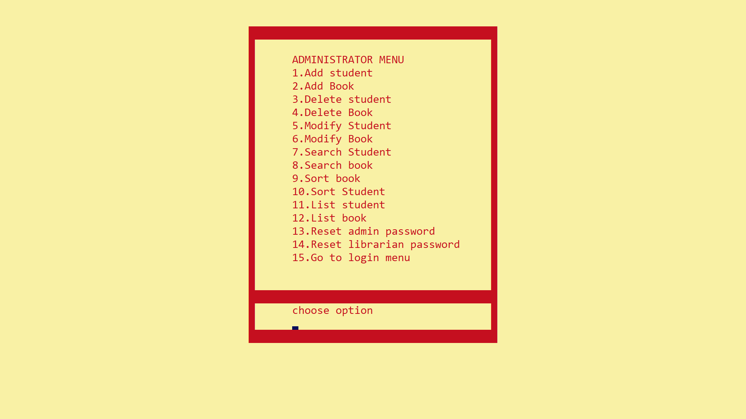
Screenshots

Slide 16
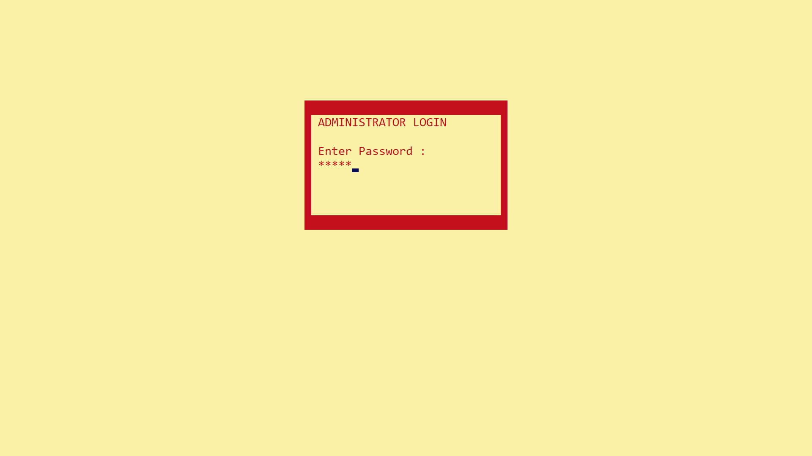
Screenshots

Slide 17
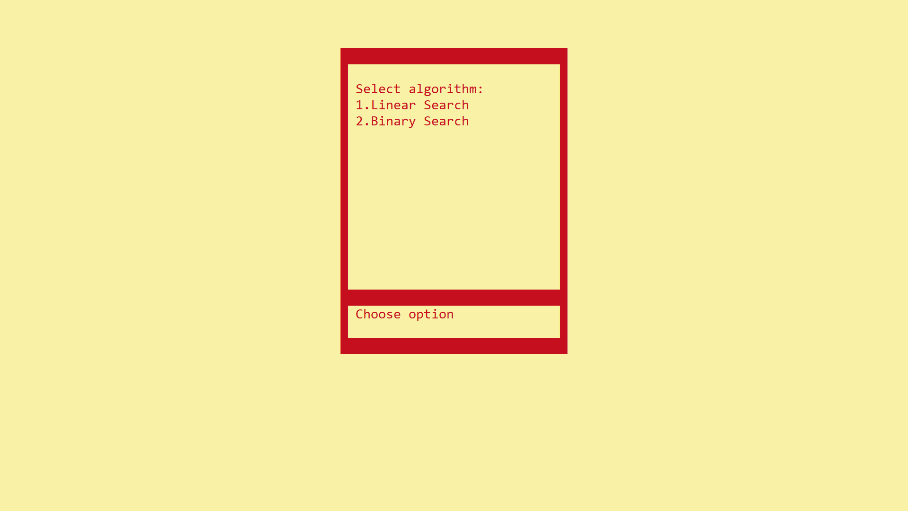
Screenshots

Slide 18
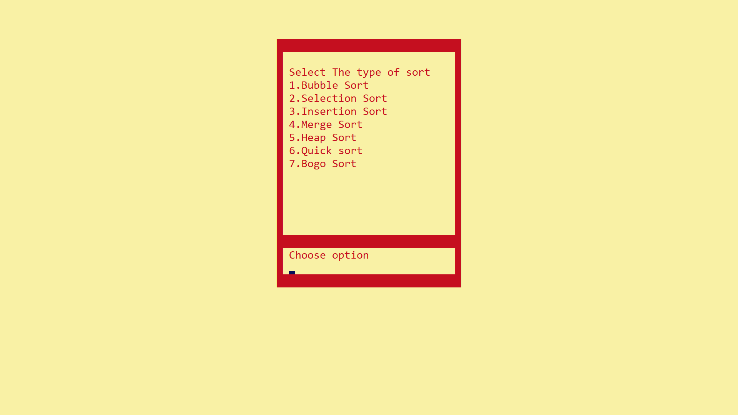
Screenshots

Slide 19
conclusion
The project has been successfully completed and tested.
In the long term, this project will make the use of library more efficient, user friendly, easier and effective.
It is a real improvement over the existing manual system as it effectively overcome all the drawbacks of the existing system.

Slide 20
Thank You
Arpan Pokharel (075bct015) Bibek Basyal (075bct097) Chirag Lamsal (075bct032)

